Slide 1
Kansas Firefighter Relief Act Lisa Collette, Administrator
Vicki Schmidt
Commissioner of Insurance
Kansas Insurance Department

Slide 2
Agenda
Contact Information
FRA Program Totals
Receipts
Expenditures
Assets
Relief
FRA Loans
Workers Comp
FRA Business Affairs
Redeterminations and Hearing
KORA
FRA Best Practices
Things to Remember

Slide 3
Kansas Insurance Department
Vicki Schmidt
Commissioner of Insurance
420 SW 9th Street
Topeka, KS 66612
Phone: (785) 296-3071
Fax: (785) 296-7805
www.ksinsurance.org
kid.commissioner@ks.gov
Consumer Assistance Hotline:
1-800-432-2484

Slide 4
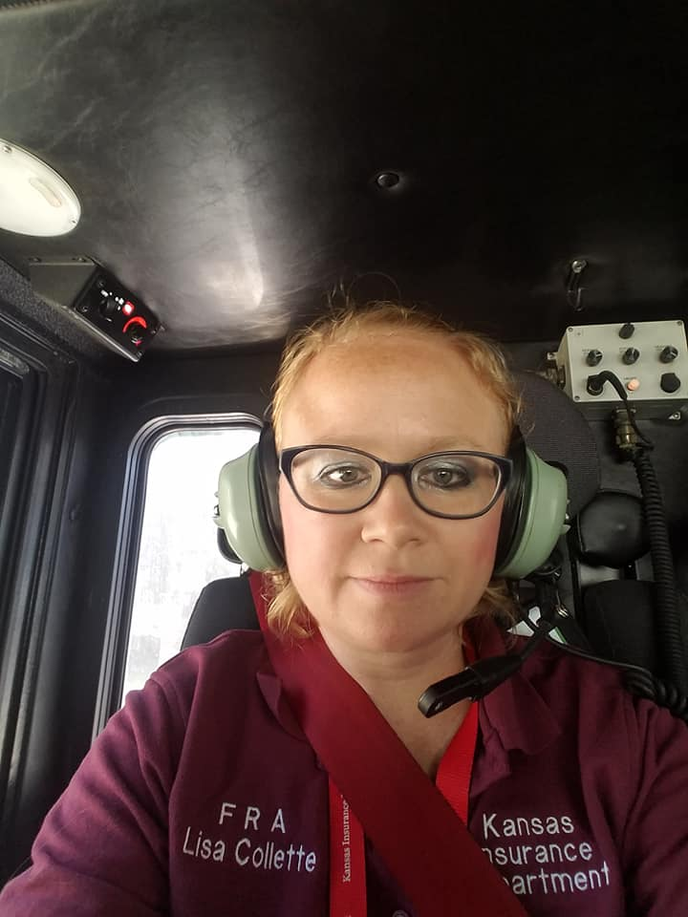
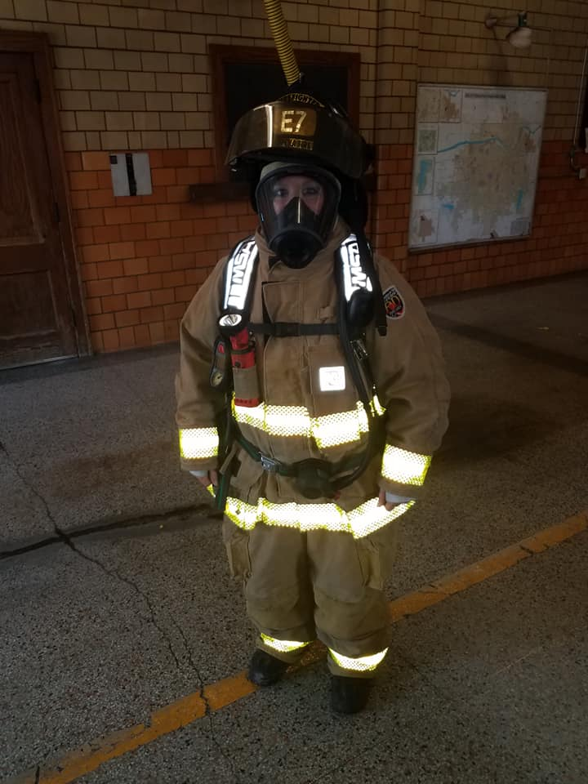
Ride-a-longs with Topeka Fire
August 7th and 17th 2018

Slide 5
Other Services

Slide 6
Kansas Firefighters
-Kansas Firefighters
Firefighter Relief Act
ISO Public Protection Classification

Slide 7
FRA Online Program

Slide 8
2019 FRA Training
Concordia March 2
Plainville June 1
SCAFFA
March 21
Booth
FRA Seminar Jan. 19
Ellinwood Sept. 14
KSFFA Conference
Salina
April 25-27
Clearwater
May 18
Galena
July 13
Downs
Dec. 7

Slide 9
Financial Statement Submissions
Remember they are due on or before April 1.

Slide 10
FRA Premium Tax Collected
Trend

Slide 11
CY2017 FRA Receipts
KID Check
$12.6 Million
Insurance Proceeds
$2.3 Million
Annuities
Pensions
$4.4 Million
Bank Interest
$118 Thousand
$20,900,631.65

Slide 12
CY2017 FRA Expenditures
Relief to Firefighters
$1.5 Million
Insurance Premiums
$9.2 Million
Annuities Pensions Paid
$2.4 Million
Other
$371 Thousand
Annuity/Pension Reinvestment
$2.9 Million
$14,686,557.27

Slide 13
Assets/Investments
Bank Accounts
$31.7 Million
Interest
$118 Thousand
Annuities Pensions
$54.2 Million
Gain
$4.4 Million
$88,098,294.77

Slide 14
Kansas FRA Fund Summary
Description | CY2013 | CY2014 | CY2015 | CY2016 | CY2017
Receipts | $19,472,619 | $16,228,047 | $16,369,162 | $17,881,749 | $20,900,631
Expenditures | $15,248,436 | $16,965,033 | $15,486,059 | $13,838,245 | $14,686,557
Assets | $75,083131 | $77,444,295 | $77,658,351 | $81,848,242 | $88,098,294
Overall Net Change | $5,916,336 | $2,361,164 | $214,056 | $4,189,891 | $10,117,246

Slide 15
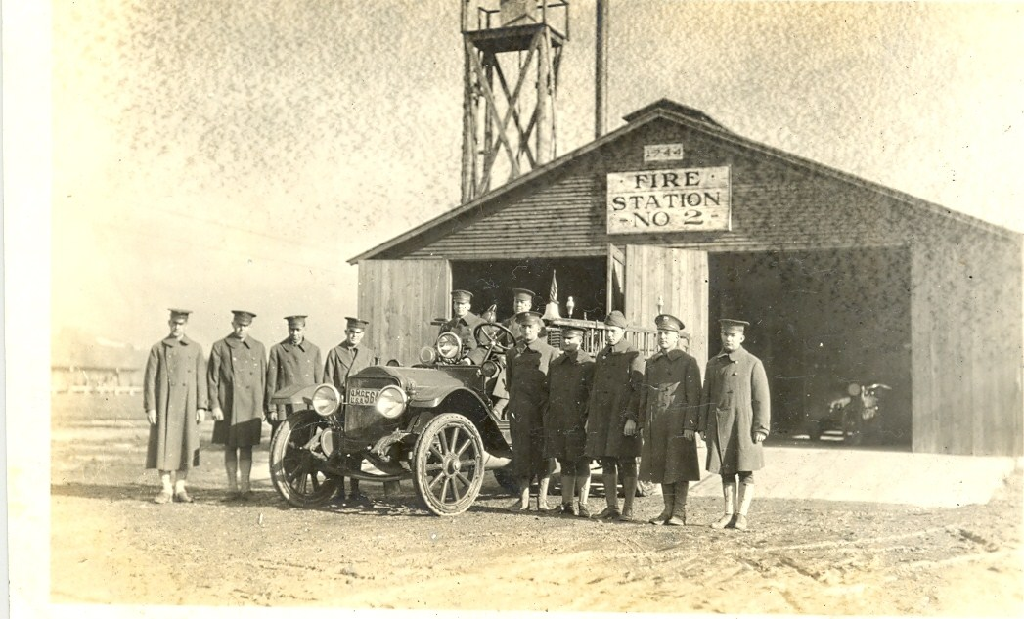
Kansas Firefighter Relief Act Distribution
In CY2017 over $12 mil. was distributed to 563 FRAs across the state.

Slide 16
Distribution Requirements
Each FRA receives a “base” distribution of $1,000
The KSFFA receives 3% of the premium tax collected
$100,000 goes to the KSFFA for a statewide death benefit fund.

Slide 17
CY2017 Distribution Must Funds
$1,164,863 is subtracted
from the Premium Tax
$13,528,771
FRA Premium Tax CY2017
$502,863 KSFFA
$100,000 KSFFA Death Benefit
$562,000 Base Distribution to all FRAs

Slide 18
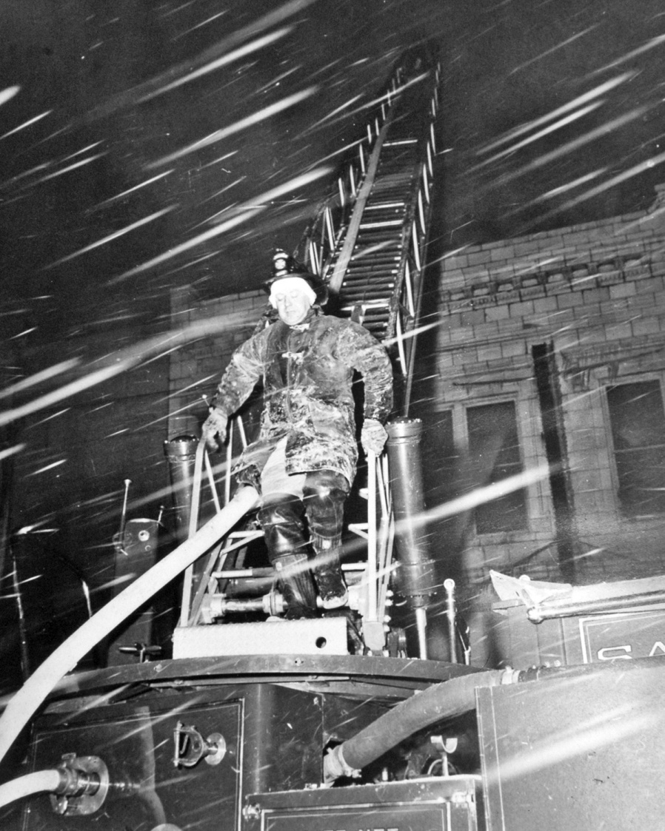
Kansas Firefighter Relief Act
$100,000 is paid to the Kansas State Firefighters Association to be set aside as a death benefit fund,
$65,000 benefit for Firefighter LODD (currently)

Slide 19
The Firefighter Relief Act

Slide 20
What is the Firefighter Relief Act?
Establishes a Firefighters Relief Fund for firefighters injured or killed in the line of duty.
2 states have a firefighter relief act:
Kansas:
562 FRAs
$13 Million fund
2 Employees to manage & administer the fund
Pennsylvania:
2,000 FRAs
$70 Million fund
45 Employees to manage & administer the fund

Slide 21
Where do we get the money to fund the Firefighter Relief Act?
From all Fire and Lightning Insurance written in the state for the previous year.
2% tax on premiums of fire and lightning insurance written in the state.
This 2% tax funds the Kansas Firefighter Relief Act

Slide 22
How are the Funds Distributed?
The funds are distributed to each FRA based on the population and valuation of the geographical area served by the fire department.
50% of the distribution is based on the population
50% of the distribution is based on the assessed tangible property valuation

Slide 23
What does relief mean?

Slide 24
FRA Definition: Line of Duty Death or Injury
There are many different definitions for a Firefighter Line of Duty Death or Injury:
State Policy
Local Policy
Workers Comp
Public Safety Officers Benefit
Relief
of any member of the fire department of such city, township, county or fire district
Death Benefit
injured or physically disabled in or by reason of the discharge of such member’s duties as a firefighter
when any member of such fire department is killed in the discharge of such member’s duties as a firefighter
or who dies from the effect of injuries so received or from disease contracted by reason of such member’s duties as a firefighter

Slide 25
Line of Duty Death
The FRA can and should pay for funeral expenses.
The FRA can provide a death benefit to the family.
Your governing body attorney should be notified immediately and informed of the situation and statutory provisions.

Slide 26
What does “Relief” Mean?
Removal
in whole or in part
the financial burden, hardship or distress
Firefighter, their widow or dependents
resulting from injury or physical disability to a firefighter
in the discharge of their duties

Slide 27
Attorney General Opinion “FRA Discretionary Power”
Relief
Within reasonable limits, depending on the funds available and the circumstances of financial need resulting from such injury or physical disability to a firefighter
Assistance
the amount of financial assistance to be paid as relief to such firefighter’s spouse or dependents
Power
falls within the discretionary power of the FRA to administer the fund

Slide 28
Types of Injury Relief
Emergencies
Injuries to, from and during
Disease
Contracted by reason of the member’s duties
Disability
By reason of the discharge of a member’s duties
Distress
Mental and emotional distress that requires medical intervention by reason of the discharge of a member’s duties

Slide 29
Eye Glasses & Hearing Aids
Eye Glasses may be replaced using FRA funds if damaged during the performance of their duties as a FF.
Hearing Aids may be replaced using FRA funds if damaged during the performance of their duties as a FF.
Any Expenditure over $1,500 must be approved by governing body attorney.

Slide 30
Unauthorized Use of the Funds
Expenses of members attending conventions, training or seminars.
Donations to cities, townships, counties or fire districts.
Dues to the Kansas State Firefighters Association, Inc.
Purchase or cleaning of clothing.
Banquets, luncheons, dances, etc.
Capital expenditures (equipment, protective clothing, motor vehicles.
Personal loans
Training Manual, magazines or periodicals

Slide 31
Members of the FRA

Slide 32
Member of the FRA
KSA 40-1707 sets specific prerequisites for any relief or benefit to be available to the members of the firefighters relief association who is injured, physically disabled or killed in or by reason of the discharge of such member's duties as a firefighter.
The entitlement of relief or benefit under the Relief Act is exclusively determined upon the function and duties of the intended recipient as a firefighter. The function of the individual as a firefighter is essential in qualifying for any relief under the relief act.

Slide 33
Definition of a Firefighter
The Kansas Act of Discrimination K.S.A. 44-1112
(f) "Firefighter" means an employee, the duties of whose position are primarily to perform work directly connected with the control and extinguishment of fires or the maintenance and use of firefighting apparatus and equipment, including an employee engaged in this activity who is transferred to a supervisory or administrative position.

Slide 34
What are the duties of a FF?
Mopping the floor
Washing the truck
Weather Spotting
Cake Walk
Assisting on EMS calls
Fire Prevention Education Activities
Fire Department Paperwork
Installing Smoke Detectors

Slide 35
Who Deserves FRA Benefits?
All members of the Fire Department that have the duties and functions of a firefighter.
If you think there is a Firefighter that does not deserve FRA benefits, then what are they doing on your Fire Department!
You have an internal Fire Department issue and not a FRA problem
FRA Benefits

Slide 36
Firefighter Relief Act Coverage
A member of a fire department is protected by the Firefighter Relief Act from the first day of service with such department, (there is no “opt out” provision)
regardless of any probation status.
Association Bylaws must be consistent with the statutory purpose
and can not define a “member” in a way that would categorically exclude a firefighter.
You can not deny benefits to firefighters
based on length of service unless it is covered by statute.

Slide 37
Non Members or Members with no FF Duties
There is no entitlement to benefits for “Non Members” or Members with no Firefighting duties.
There is no authorized purpose for these people to receive any benefits under the provisions of the Relief Act.
If I receive information that this situation exists within your FRA, I will notify the County Attorney to take action to rectify the situation and your FRA will be unqualified for funds until the County Attorney notifies me that it is resolved.

Slide 38
Non Members of the FRA Board of Directors
The FRA is composed of “members of a fire department” (K.S.A. 40-1701(a)
An FRA Board of Directors Member (or Officer of the Corporation) may be a “non-member” if:
The FRA Bylaws allow for the inclusion of non-members to be included in the FRA Board of Directors.
Any non-member officer on the FRA Board of Directors is not authorized to receive any FRA benefits.

Slide 39
FRA Members Providing Service to Multiple Fire Departments
Firefighters may belong to several Fire Districts and there is no conflict with the Relief Act when this occurs.
Any Firefighter that is a member of any Fire District or Department in the state of Kansas is entitled to receive the same benefits that any other member of “the” Department receives.
Service time remains with each Department separately and can not be combined unless there is a merger of FRAs.

Slide 40
Service Time
“Service Time” relates to the time on “such” department. “Such” means your department only.
Service time from another department is not counted unless it is the result of a merger of FRAs.
Service time is “cumulative” with such department and stays with the FF throughout their career.

Slide 41
Insurance & Annuities

Slide 42
Benefits: Insurance, Annuities, Pensions
On Duty
Limited to On Duty Death or Injury
24 Hour
Coverage for On and Off Duty Injury and Death
10/5 Rule
Policy transfer at Termination
Annuities
For Volunteer Fire Departments
Pensions
For Fully Paid Fire Departments

Slide 43
Types of Insurance your FRA can Purchase
On Duty (paid 100% with FRA funds)
Policy is limited to cover only accidental injuries, diseases, or death resulting from duties as a member of the fire department
24 Hour Coverage (FRA pays 85%, FF pays 15%)
Policy may cover non duty related accident, injury and or death
The contribution by the member shall not be less than 15 percent of the total premium for this coverage
Conditions of the Policy (FRA owns the Policy)
Each policy shall be purchased, owned and held by the firefighter’s relief association
Group Term
Group Permanent
Individual Permanent Life
Each member shall pay that portion of the cost (premium) which is beyond “on duty” coverage.
Each policy shall name the firefighter’s relief association as the beneficiary
Each indemnity shall be paid to the firefighter’s relief association

Slide 44
Types of Insurance that can be purchased using FRA Funds
Group Term: type of insurance coverage offered to a group of people. This coverage will provide a benefit to the beneficiaries if the covered individual dies during the defined covered period
Group Permanent: following the same structure as group term, the significant difference being that premiums go toward the purchase of permanent insurance instead of term insurance. The member has a vested interest in the increments of paid-up insurance purchased
Individual Permanent: this is also referred to as Whole Life Insurance. An umbrella term for life insurance plans that do not expire (unlike term life insurance) and combine a death benefit with a savings portion. This savings portion can build a cash value
The FRA owns the policy

Slide 45
Types of Insurance your FRA can’t Purchase:
Insurance
Health Insurance
Dental Insurance
Exception
If the firefighter gets damage to their eye in the line of duty then the FRA can use the funds to pay for their bill to the eye doctor.
If the firefighter loses a tooth and/or teeth in the line of duty then the FRA can use the funds to pay for their dental bill.
The exception to this rule is Cities of the 2nd Class with both career and volunteer firefighters.
Vision Insurance
Air Ambulance Policy
Cancer Policy
If the firefighter gets hurt in the line of duty and needs to be airlifted to a hospital, then the FRA may use the funds to cover the cost.
There has been a company in Kansas who has had a Group Term Policy with a Cancer Rider attached got approved this year.

Slide 46
FF Beneficiary Designation
FRAs are the owners and beneficiaries of any insurance policy in accordance with (IAW) K.A.R. 40-10-6.
The FRA and/or agent maintain beneficiary forms covering individual members.
Beneficiaries of your FRA Life Insurance policies need to be kept current.

Slide 47
Name the Beneficiary
The local FRA and/or agent will have a beneficiary form for you to complete, and a beneficiary will need to be identified.
Make sure this form is current.
Your beneficiary will receive the insurance benefits federal income tax-free, and life insurance benefits do not have to go through the probate process.
If you die without naming a beneficiary, the death benefit will be paid out according to K.S.A. 40-1707(a)(2). This delays the payment and could create a financial hardship for your beneficiary.

Slide 48
Minors as Beneficiaries
Children should not be designated as a beneficiary without first consulting with a family/estate attorney.
Note that even if you have named a guardian as beneficiary, the proceeds may not be paid until the court has specifically appointed a guardian or approved the named beneficiary as guardian for the minor(s).
Life insurance companies won't pay the proceeds directly to minors. If you haven't created a trust or made any legal arrangements for someone to manage the money, the court will appoint a guardian, a costly process, to handle the proceeds until the child reaches 18.

Slide 49
Number of Beneficiaries
You may specify as many beneficiaries as you want to receive the benefits as prescribed on your local FRA beneficiary form.
It is a good idea to name a contingent beneficiary to receive the death benefit in case your primary beneficiary dies before or at the same time as you.
Let your beneficiary know the kind of insurance policy you have, any changes you make, and where the policy is filed. A change in beneficiary may be made after the policy is taken out, unless you have named an irrevocable beneficiary.
An irrevocable beneficiary arrangement can only be changed with the beneficiary’s consent. Your agent can arrange for a change in beneficiaries or you can do it by contacting your local FRA and asking for the appropriate form.

Slide 50
No Named Beneficiaries
In the event that no beneficiary has been designated to receive such death benefit, the following persons in the following priority will receive the benefit IAW K.S.A. 40-1707(a)(2)(A):
(A) If there is a spouse and there are no natural or adopted children of the deceased
member, the death benefit shall be for the spouse;
(B) if there are one or more natural or adopted children and spouse of the deceased
member, 1/2 of the death benefit shall be for the spouse and the remaining 1/2 of the
death benefit shall be for the children, in equal shares thereof;
(C) if there are one or more natural or adopted children and there is no spouse of the
deceased member, the death benefit shall be for the children, in equal shares thereof;
(D) if there is a father or mother, or both, and there are no natural or adopted children
and no spouse of the deceased member, the death benefit shall be for the father or
mother, or to both in equal shares thereof if there are both;
(E) if there are one or more siblings and there is no father or mother or spouse and there are no natural or adopted children of the deceased member, the death benefit shall be for the siblings, in equal shares thereof; and
(F) if there are no siblings, no father or mother, no natural or adopted children and no
spouse of the deceased member, the death benefit shall be for the estate of the deceased member;

Slide 51
10/5 Rule Cash Value at Termination
FRA maintains 85% of cash value if 10/5 rule not met
The FRA keeps $850
FF is eligible for his portion of the cash value (15%) if 10/5 rule not met
The Firefighter receives $150
FF is eligible for 100% of cash value if 10/5 rule is met
The Firefighter receives $1,000
$1,000 Cash Value in
Insurance Policy

Slide 52
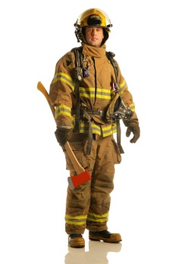
Illustration ($50,000 Benefit)
>60 Year Old
$1,000/Yr Premium
25 - 50 Year Olds
$500/Yr Premium
<25 Year Olds
$100/Yr Premium

Slide 53
On Duty Coverage Only
FRA Pays 100%
The FRA Pays $100
The FF pays “0”
The FF is not required to contribute any portion of the premium
$100 Annual Premium
On Duty Policy Only

Slide 54
24 Hour Coverage (policy)
FRA pays 85%
The FRA pays a maximum of 85% of the total premium
FF pays15%
The Firefighter contributes a minimum of 15% of the total premium
The FRA Pays
$85
$100 Annual Premium
24 hour coverage
policy
The Firefighter
contributes $15

Slide 55
FFs that Refuse to Contribute 15%
If a member refuses to pay his/her share (15%) then the FRA will pay for an "On Duty" policy only in an amount equal to 85% that is contributed to all the other policies.
So, if a 24 hour policy has a total premium of $100, then the FRA would purchase an "On Duty" only policy for whatever you can provide for $85.

Slide 56
Life Insurance 10/5 Rule
To summarize, those FFs who meet the 10 years of service with 5 years coverage under the same policy are authorized, at termination, for transfer of ownership of the policy.
If the FF does not meet the 10/5 requirement, they are authorized to receive only the 15% of the cash value of the policy.
The cash value (if any) remains in possession of the FRA, however the FF can pay the cash value amount to the FRA and can then be eligible for transfer of ownership of the policy.

Slide 57
FFs that are Denied Insurance
You must provide benefits to FFs that are denied insurance coverage for what ever reason.
You can provide other equivalent benefits based on the same contribution that other members are receiving.
The benefits can be term insurance and or an annuity product; you can not just write out a check

Slide 58
Annuities
20 years of service
With such department, does not have to be continuous
75% of fire calls
Which the FF was available to attend as verified by the governing body
Deferred or Immediate
The Annuity may be Deferred or Immediate as determined by the FRA Bylaws
Annuity

Slide 59
Attendance to 75% of the Fire Calls
K.S.A. 40-1707(c)(1) states that the member must have attended 75% of the fire calls that he was available to attend, as verified by the governing body.
Have the Fire Chief draft up a letter that states Firefighter Joe Bob has attended no less than 75% of the calls that he was available to attend and submit it to the governing body.

Slide 60
Paying out Annuities
Some FRAs do not take money out of their annuities, because of the interest they are receiving.
Instead, they purchase an “Immediate” annuity using FRA funds in the checking account.
This is not in conflict with the statute.
Annuities must be approved by the Governing Body Designated Attorney prior to Purchase.

Slide 61
Different Types of Annuities
Fixed Annuity: Earns interest set by the by the company (or contract provider) and is guarantees it will pay no less than a minimum rate. No risk.
Indexed Annuity: Interest is earned based on an equity reference (S&P) stock index. These annuities also have a guaranteed minimum rate and the value of the annuity will not drop below a certain level. Less downside risk, potential greater return.
Variable Annuity: The principal and earnings are not guaranteed, they depend on the performance of the investment options (stocks, bonds etc). High risk, high reward.

Slide 62
Annuity Calculation Method-Examples
There are many ways to determine a member’s share of an annuity:
Number of years of service X a dollar amount
Example: 20 years of service X $100 equals $2,000
Amount of the annuity divided by the number of FFs
Example: 20 FFs divided by $200,000 annuity value equals $10,000
% of Annuity, number of FFs divided by the number total number of years of service
Example: 20 FFs divided by 200 years of service equals 10% of the total annuity value, $200,000/10% equals $20,000.
A set amount
Example: $2,000 upon retirement no matter the number of years

Slide 63
Individual Annuities
Each FF has an annuity with their name on it but it is owned by the FRA
The FF can only receive this annuity if the statutory requirements are met (20 years of service and 75% of the fire calls)
Contributions by the FRA can be made to these at any time
Interest is accumulated over the years and the value grows
Once the statutory requirements are met, the annuity can be issued to the FF directly or it can be cashed in by the FRA then issued out.

Slide 64
Group Annuities
In some contracts or agreements;
The contract provider may work directly with the member to determine a payout method.
The member has a 30 day “free look” period to make up their mind.
You may roll the payout into another annuity via 1035 transfer.
You may cash the annuity in and there may be a service charge or penalty.

Slide 65
Annuity Contributions
The FRA may contribute funds to the annuity at any time as long as the contract allows it.
A FRA can setup a FF contribution option with the following in mind:
The annuity contract must allow it
The FRA contribution and the FF contribution must be tracked and identified
If the FF terminates prior to 20 years of service, only eligible for FF contribution

Slide 66
Important to Remember
It is the “contribution” by the FRA that must be fair and equitable
Not necessarily the benefit amount

Slide 67
Appropriate Investments
Investments are to be approved
by the Governing Body
Temporary Notes or No Fund Warrants
Time Deposit Open Accounts CDs, Time CDs
In banks, savings and loan associations which have offices located in such investing governmental unit
Repurchase Agreements
Or the state of Kansas if greater interest rate
Issued by such investing governmental unit
If no office in such investing governmental unit then in banks which have offices in the county or counties in which all/or part of such investing governmental unit is located
In banks, savings and loan associations which have offices located in such investing governmental unit
If no office in such investing governmental unit then in banks which have offices in the county or counties in which all/or part of such investing governmental unit is located
US Treasury bills or notes
Not to exceed 2 years maturity
In banks, savings and loan associations, the federal reserve bank of Kansas City or with primary government securities dealers

Slide 68
Appropriate Investments Cont’
Municipal Investment Pool
Managed by trust departments of banks which have offices located in the county.
Multiple Municipal Client Investment Pool
office in such investing governmental unit then in banks which have offices in the county or counties in which all/or part of such investing governmental unit is located
Treasury Bills Municipal Investment Pools
Shall be utilized only if the banks, savings and loan associations and savings banks eligible for investments cannot or will not make the investments authorized at equal to or greater than the investing governmental unit interest rates.

Slide 69
Inappropriate Investments
You can not take your FRA funds to a local investment firm and have them play the stock market
You can not have a local investment firm obtain a mutual fund using your FRA $
You can take your FRA funds to a local investment firm and have them establish an annuity

Slide 70
Workers Comp
Firefighters are covered by workers comp
However, some of the duties are not covered under workers comp

Slide 71
Workers Comp Employer Defenses
Employer didn’t receive proper notice (20 days)
Employee intended to cause the injury
Employee failed to use proper protection required by statute, workplace safety rules, or his/her employer
Engaged in Fighting or Horseplay
Employee was under the influence
Accident doesn’t Arise Out of Employment
Notes:
I am going to go over these bars to recovery in the next few slides. With each I will provide a case where the court addressed each defense. These cases might bring up more questions. Today, I can only tell you what the court said with those specific facts. Questions about different scenarios will need to be addressed by your governing body attorney. Sorry to all the attorneys out there…
Note: If your workers compensation claim is denied due to any of these reasons you may still receive benefits through your FRA, the federally funded Public Safety Officers Benefits Act or an accident policy purchased by your FRA or governing body, if applicable. You’ll need to consult your Governing Body Attorney, or John Boyd with the Firemen’s Relief Fund for more information.

Slide 72
Actual Denied Cases
Injury/death while driving fire department vehicle not wearing seatbelt.
Washing Fire Department vehicle/apparatus.
Shoveling snow from the sidewalk in front of the Fire Station.
Completing paperwork at the Fire Department.
Driving POV to and from the Fire Department.

Slide 73
Workers Comp Death Benefits
Death Benefits are provided to the Employee’s Dependent Family members
Initial Payment: $40,000
50% to spouse, 50% to child
Thereafter: Average Weekly Wage x .6667
50% to spouse, 50% to child
Payment Period
Spouse: For Life or until the $300,000 max is established.

Slide 74
Summary of $ for FFs that die in the Line of Duty in the state of Kansas
KSFFA Statewide Policy: $65,000
PSOB: $343,589
WC: $40,000
WC Funeral: $5,000
Local FRA Death Benefit: $????
Local FRA Funeral Service: $????
Local FRA Life Insurance: $????
Total $443,589

Slide 75
Loans of FRA Funds
FRA Loan
City
TWP
Improve
Fire Department
Equipment
Paid Back
Semiannually
<6% Interest
County
Fire District
$1.4 Million in Loans

Slide 76
What Are Improvements to the Department or Equipment
Purchase of a Fire Truck is most common
Airpacks/Compressors
New Station Construction or Addition
Firefighter Turnout Gear

Slide 77
Loan Warrant Contract
Make sure you have a signed loan warrant in place
Make sure the governing body attorney is involved and certifies the contract
We have a sample contract in the FRA Handbook
We can send you an electronic version upon request
Send me a copy and I will upload it into your FRA Online File.

Slide 78
Loan Warrant Interest-How to Report it?
Loan Interest Here

Slide 79
Reporting Loans on Financial Statement- Under Assets
Next year’s payments will be deposited in your checking account
Decrease the loan warrant amount by the same deposit amount

Slide 80
Junior Firefighter Program

Slide 81
Kansas Child Labor Law K.S.A. 28-602
Boy Scouts of America
No child under eighteen (18) years of age shall be at any time employed in any:
occupation, trade or business
which is in any way dangerous or injurious to the life, health, safety, morals or welfare of such minor.
If they're underage, you're liable because minors can’t be held fully accountable for their behavior.
So, if you have an Explorer program, you may have to limit their participation to just the classroom.

Slide 82
Redetermination CY2018
CY2018 Redetermination Hearing
Who Applied?
When can you apply?
Redetermination Hearing was held on November 14th at 10:00 a.m. at the Kansas Insurance Dept.
47 FRAs applied for redetermination
FRA’s may apply for redetermination every 3 years between January 1st and September 30th
1 FRA was withdrawn by Administrator
2 FRAs stand to lose

Slide 83
CY2018 Redetermination Cont.
What does this mean?
In CY2017 18 FRA’s applied for redetermination and their total bill was $43,527.04
This total bill comes off the top of the must fund from the total distribution amount that was collected through premium taxes
CY2018 Redetermination Hearing total bill of $360,792.10 will be coming off the top of the total distribution amount. That’s a difference of $317,265.06 from the previous year.
Current Distribution Amount Total | Estimated Amount Total | Difference Total
$2,413,798.98 | $2,774,601.00 | $360,792.10

Slide 84
Now What?
Final Order will be completed in March or April
44 FRA’s will see the difference in their distribution amount in June of CY2019 when the distribution is made

Slide 85
Redetermination
Requirements for Requesting a Redetermination:
You must have a “change in circumstances” in order to apply.
Apply to the Commissioner of Insurance prior to October 1 (of any year) but not more than once every 3 years.
Redetermination is now “Web” based and you can do the entire process online by going to the FRA Webpage.
The Redetermination Hearing will be conducted usually during the 3rd week of November, but in all cases it will be prior to December 1, in accordance with Statute.
You may be present during the redetermination hearing if you desire.

Slide 86
FRA Redetermination Page
You must first log into your
FRA page in the Online Program
Click on this block
for Redetermination

Slide 87
Online Redetermination
Give me a call and I will research your latest
Population/Valuation and provide you with an
estimated distribution.

Slide 88
Redetermination Continued

Slide 89
FRA Records
Records Retention
How long do you keep them
Kansas Open Records Act
Public Agencies
KORA Custodian
Procedure

Slide 90
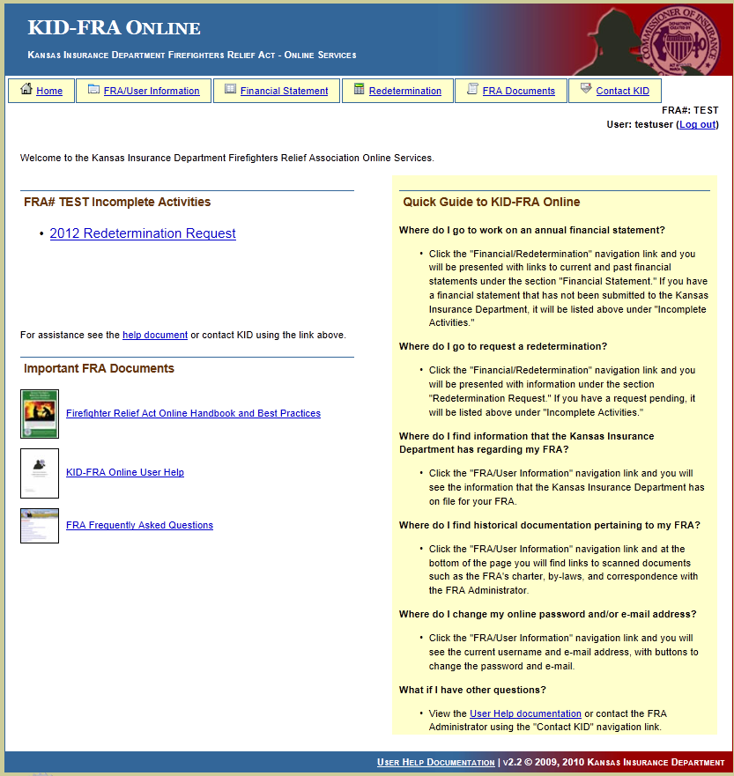
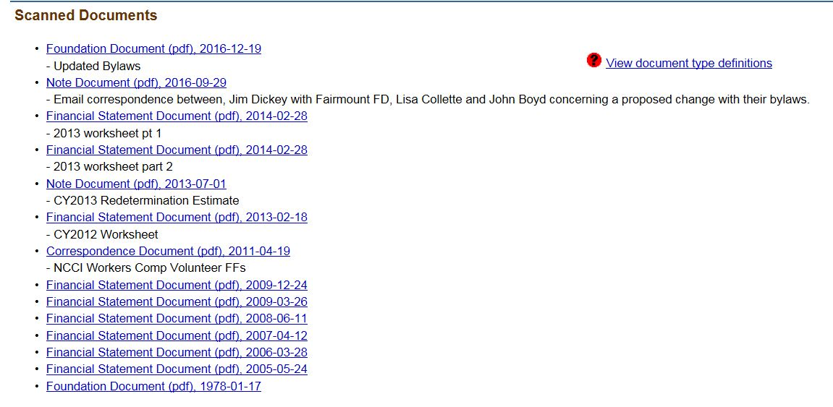
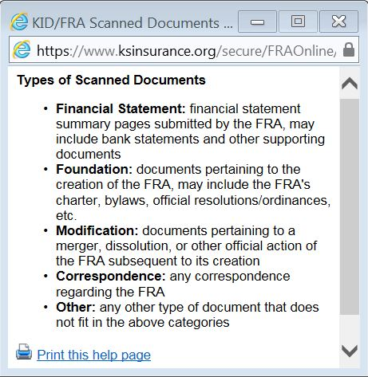
Your FRA Home Page
2017 Financial Statement

Slide 91
FRA’s without Local Jurisdiction Policies
Financial Statements-
5 Years
Bank Records-
3 Years
Articles of Incorporation and Bylaws-
100 Years
Correspondence-
Keep until no longer useful
Contracts-
Keep until expired plus 5 years
Meeting Transcripts- Keep until no longer useful

Slide 92
Kansas Opens Records Act (KORA)
Public
records must
be open to any
person.
Public records are defined as "any recorded information,” maintained or kept by any public agency.
Public Agency: agency or any entity, receiving or expending public funds.

Slide 93
KORA Records Custodian
Kansas Open Records
Information Officer
Procedure for KORA
Requests Treated the Same

Slide 94
Responding to a KORA Request
The request must be “acted upon” as soon as possible, but no later than the end of the third business day following date request is received.
The three acceptable responses to a request:
The record is provided (in the form requested if possible).
The request is under review and the records, if permitted, will follow.
The request is denied with a detailed explanation for the denial.

Slide 95
Kansas Opens Records Act (KORA) Cont.
All records are open for inspection except personnel records.
Any person may make abstracts or obtain copies of a public record.
If copies cannot be made in the place where the records are kept, the custodian shall allow arrangements to be made for use of other copying facilities.
Members of the public cannot remove a record without written permission of the custodian. K.S.A. 45-218(a).

Slide 96
FRA Best Practices
The firefighter relief association and the fire department are two separate legal entities.
The firefighters’ relief association records should not be incorporated with those of the fire department.
Relief association funds must be maintained in separate relief association account(s), and investments purchased with relief association funds must be issued solely in the name of the relief association.

Slide 97
Things to Remember
Remember, the purpose of the Relief Act is to provide relief for those firefighters that are injured or die in the performance of their duties as a firefighter.
You should submit a KFIRS Incident Report on any injury, if it is a “Non-Fire” event. Contact Sara Wood at 785-296-3401.
If it is a duty related injury, report it to your Workers Comp Coordinator and complete a KFIRS Incident Report. Contact Sara Wood.
If you write a check for over $1,500 you must first obtain certification from your governing body attorney.

Slide 98
Future of the FRA Program
Requires FRAs to have an integrated, holistic approach aligned with financial strategies, initiatives and objectives.
Requires FRAs to be compliant with all statutory provisions.
Requires the KID to maintain:
Customer Service Support
Service Delivery
Automation
Enforcement & Compliance Management
Training

